Slide 1
Call Volume Forecasting
Predictive Analysis | Time-Series Forecasting for Staffing & Resource Allocation

Slide 2
Business Problem
Call volumes fluctuate by weekday, seasonality, and external events
Under-forecasting → long wait times, SLA breaches
Over-forecasting → unnecessary staffing cost
Goal: forecast daily call volumes to support better capacity planning

Slide 3
Approach
Data preparation: daily call volume time series from Talkdesk
Exploratory analysis: trend + weekday seasonality
Modeling: ARIMA and a second seasonal model Evaluation: 28-day holdout, MAE / RMSE / MAPE
Deliverables: forecast charts + residual diagnostics

Slide 4
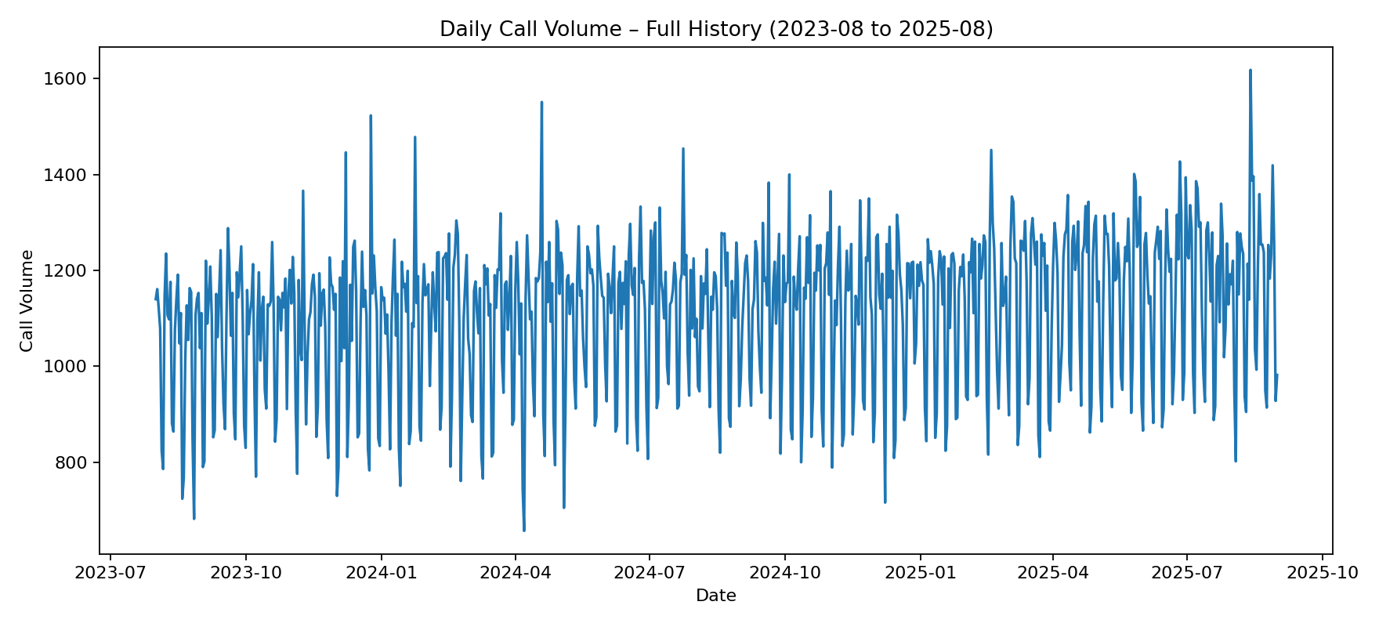
EDA – Daily Call Volume Over Time
Long-term trend and volatility in daily call volumes

Slide 5
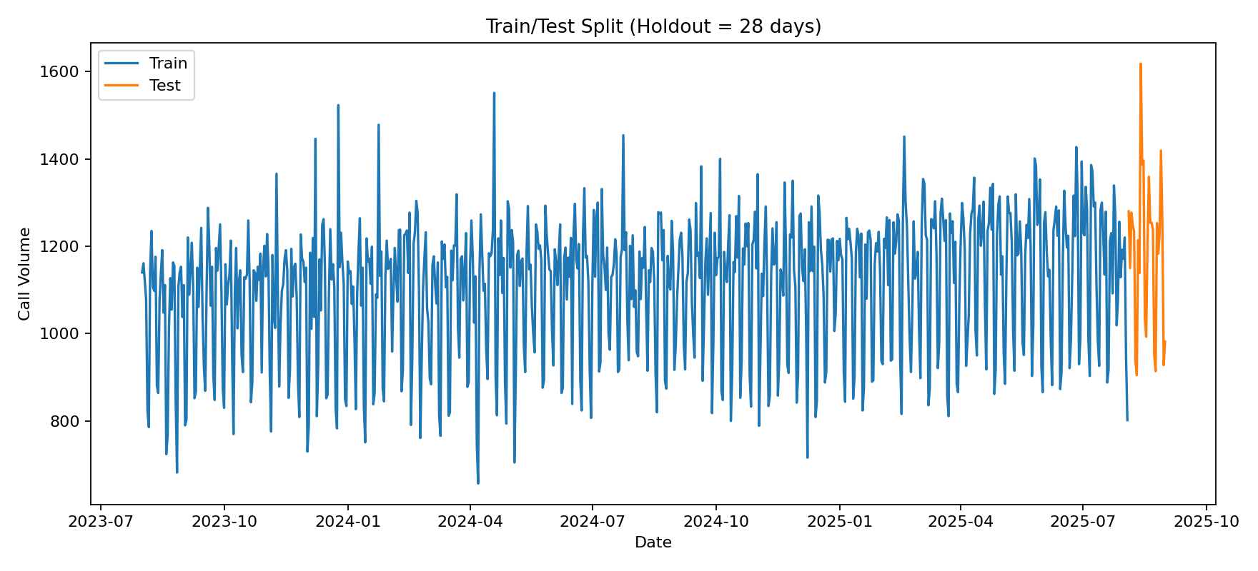
Backtesting Setup – Train/Test Split
Final 28 days used as holdout to simulate real forecasting performance

Slide 6
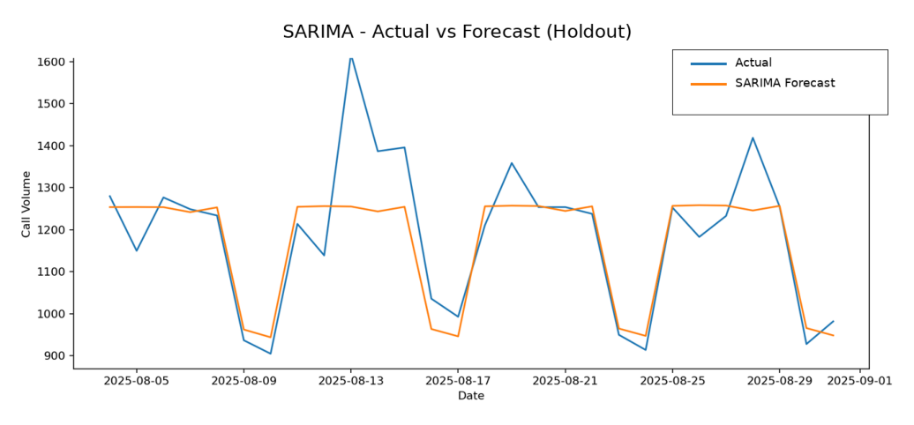
Model – ARIMA (SARIMA) Forecast
ARIMA captures weekly seasonality and short-term dynamics

Slide 7
How This Enables Better Staffing
Forecasted calls → required agent hours (WFM capacity planning)
Better scheduling reduces overtime and improves customer experience
Supports proactive decision-making (instead of reactive staffing)

Slide 8
Next Enhancements (Production)
Add regressors: marketing campaigns, outages
Move from daily → 30-min interval forecasting for scheduling
Automate pipeline: scheduled retraining + dashboard refresh
Deploy results to Power BI / Qlik for leadership reporting

